Slide 1

Predicting Flight Ticket Prices Web-Scraping/Regression
Done By:
Maitreyee Gadwe Divya Mahajan
Notes:
Hello everyone,
Our topic for the presentation is Predicting Flight Ticket Prices using Machine learning technique.

Slide 2

Problem Statement
In an era of dynamic airfare fluctuations, making cost-effective decisions for travelling is very challenging.
This involves identifying the optimum time for travel and selecting the most economical flight options to their desired destinations.
Through data-driven insights, we aim to revolutionize the way individuals plan their journeys, ensuring a seamless and budget-friendly travel experience.
Our goal is to provide a ML solution that enhances the travel experience by offering insights and recommendations for budget-conscious air travel.
Notes:
Today when airplane ticket prices keep changing a lot, it's hard to pick the best and cheapest travel options. Our objective is to address this issue by predicting ticket prices for upcoming flights to help customers in selecting the optimum time for travel and the cheapest flight to the desired destination.

Slide 3
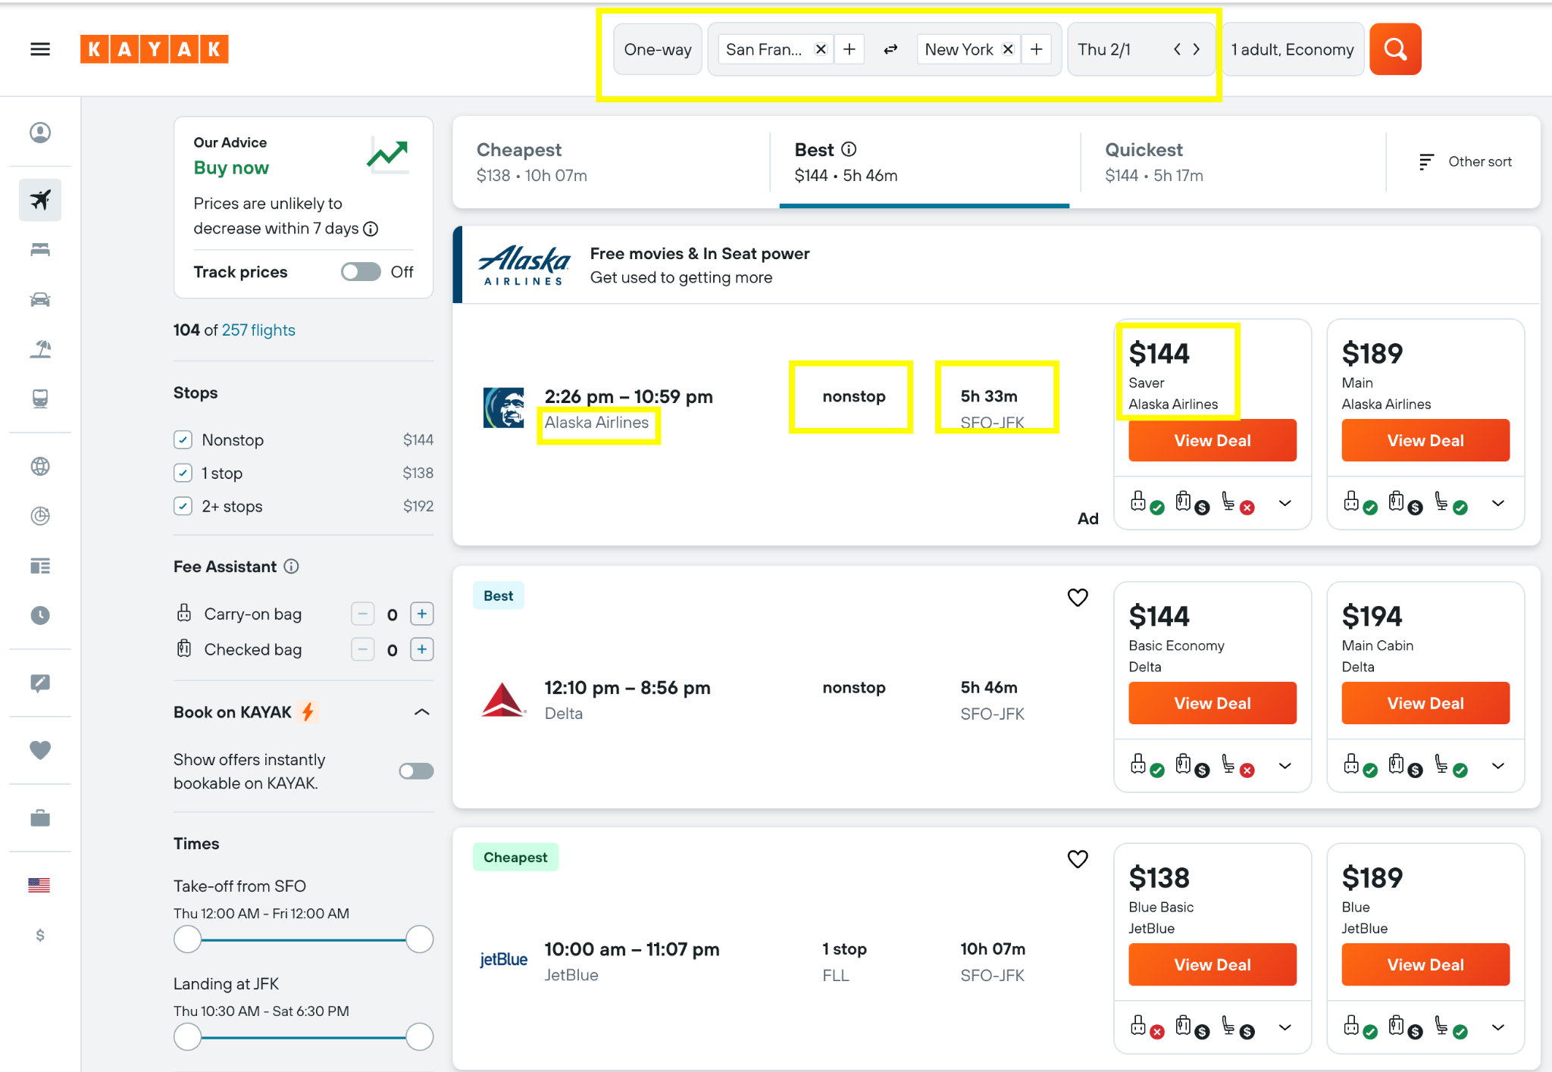
Data Collection
Scraping : https://www.kayak.com/
Source & Destination
Date (Feb, 2024)
Price
Duration
Total Stops
Airline
Notes:
The first step to achieve our goal is data collection.
We have used Selenium and BeautifulSoup to scrape data from the Kayak website.
We then Gathered data for 12 specific routes for dates between February 1, 2024, and April 30, 2024.
We organized the data into CSV files for each route.
This dataset includes features like Source & Destination, Date of flight scheduled, Price, Duration, Total Stops and Airline name serving as a backbone for model adaptability.

Slide 4
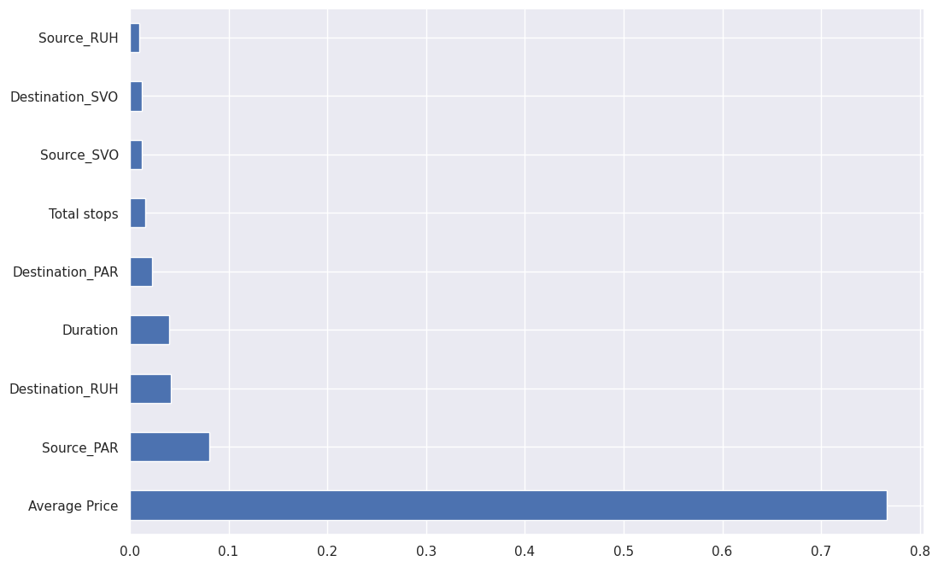
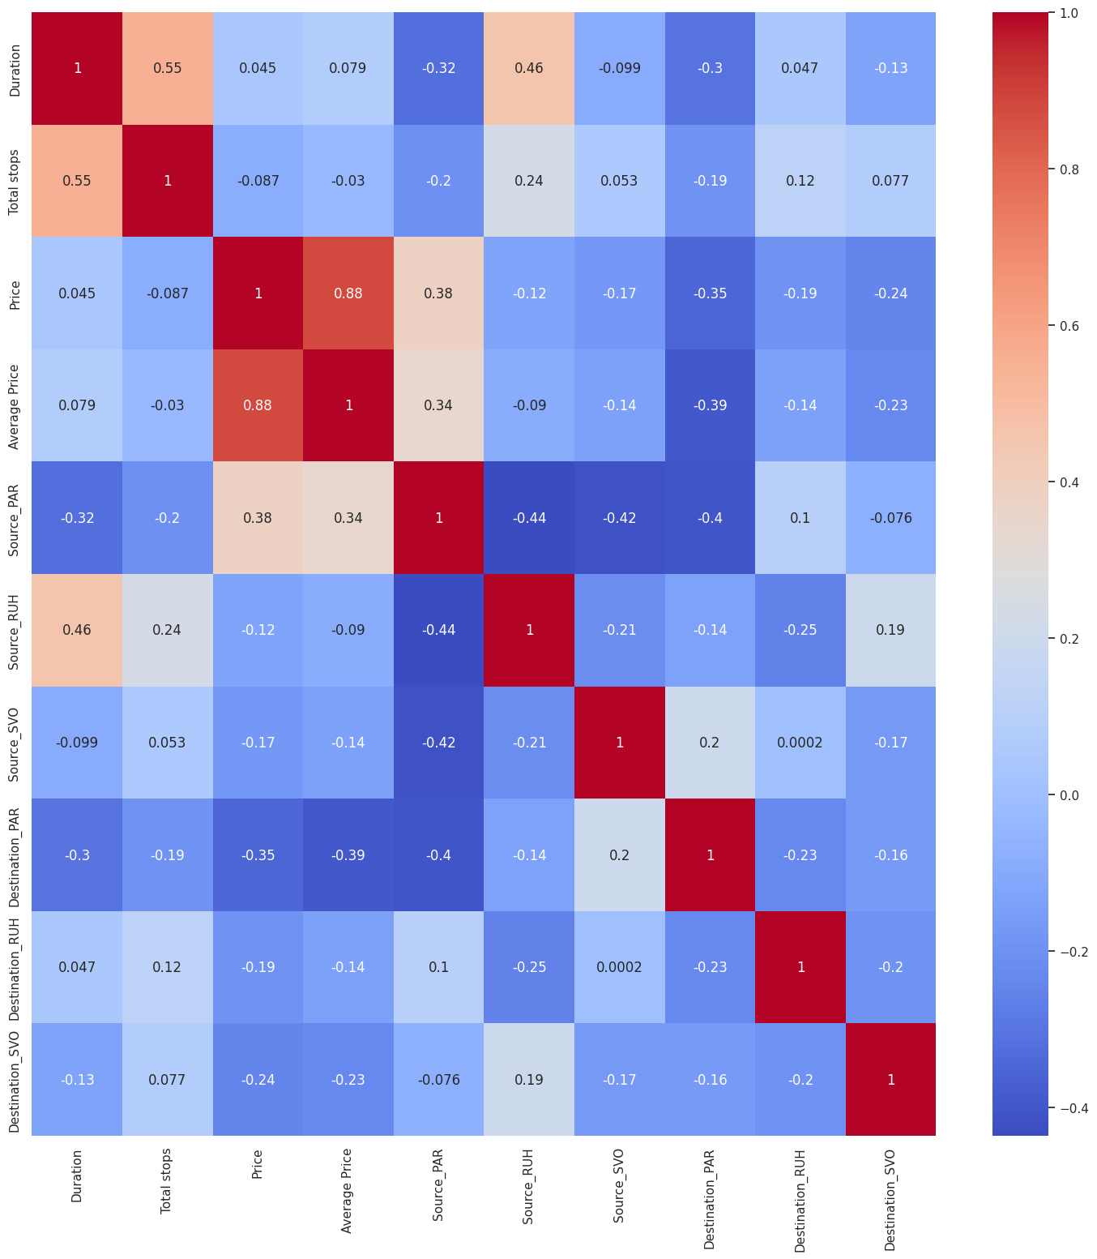
Features Analysis and Importance
Notes:
The Extra Trees Regressor model has provided insights into the significance of various features concerning their impact on predicting flight prices
The most influential feature in predicting the flight price is the average price itself. This high importance score suggests that the average price has a substantial impact on determining the final flight price.
Next,
In the correlation Matrix, we found that There is a moderate positive correlation of approximately 0.55 between the duration of the flight and the total number of stops. This suggests that flights with longer durations tend to have more stops, which is intuitive as longer flights often require layovers or multiple stops.
The correlation between the actual price and the average price is quite strong, with a coefficient of around 0.88. This high positive correlation implies that the actual price and the average price are highly positively correlated, indicating that they tend to move together.
To sum up, our correlation analysis and feature importance assessments have pinpointed the pivotal role of the 'Average Price' feature in forecasting flight costs.

Slide 5
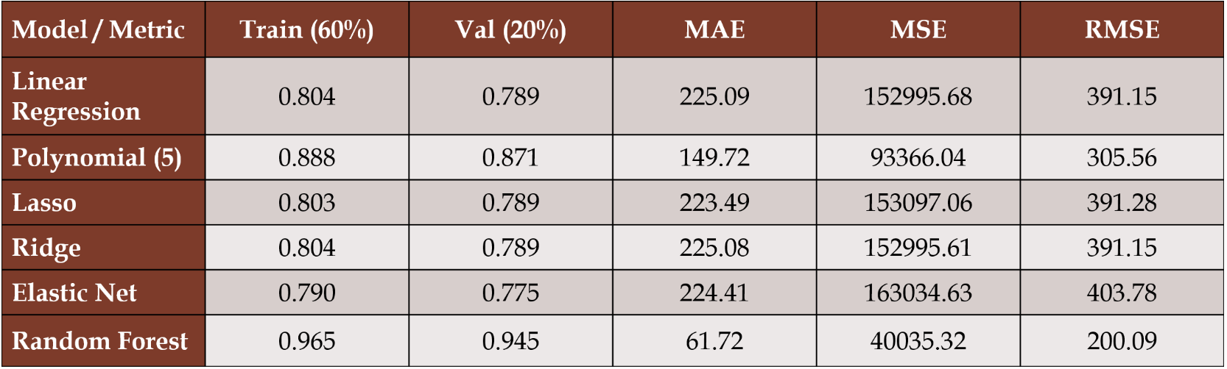
Experiments: Data Modeling and Model Selection
Notes:
Our dataset was split into three segments: 60% for Training, 20% for Validation, and 20% for Testing.
We dove into various regression models, exploring Polynomial regression up to 5 degrees. In our evaluations, Polynomial regression’s higher degrees showed improvement, but then there was a risk of overfitting.
The standout performer was the Random Forest Regression. Its robustness and exceptional predictive accuracy surpassed other models.
To enhance our models, we applied Feature Scaling techniques. However, despite our efforts, we didn't observe a significant performance boost.
After an extensive analysis of regression models, the Random Forest algorithm emerged as the frontrunner. Its favorable performance metrics made it the optimal choice for our predictive model.

Slide 6
Results: Model Evaluation (Random forest)
Retraining the random forest model on train + val and scoring on test and hyperparameter tuning using random search CV
R2 Score: 0.945
Mean Absolute Error (MAE): $61.87 Mean Squared Error (MSE): 40409.87 Root Mean Squared Error (RMSE): $201.02
This exceptional performance validates its effectiveness in forecasting ticket prices within an approximate margin of $61.87.
Notes:
Our Random Forest model underwent a crucial retraining phase, incorporating both training and validation datasets to boost its predictive capabilities.
Next, we implemented Hyperparameter tuning using Randomized Search CV. This method rigorously explored various hyperparameter combinations through 5-fold cross-validation, aiming to minimize mean squared error.
However, our findings revealed that the model's performance did not notably improve. This suggests that the initial model configuration may already be quite close to its optimal settings.
In conclusion, our RandomForestRegressor model exhibited remarkable predictive performance.
These insights show, That the final model displayed outstanding accuracy, forecasting ticket prices within an approximate range of $61.87 on the test set.

Slide 7
Thank you!
Notes:
The first step to achieve our goal is data collection.
Our project relies on extracting detailed data from Kayak website (https://www.kayak.com/). We have used Selenium and BeautifulSoup for web scraping. We then Gathered data for 12 specific routes from Kayak for dates between February 1, 2024, and April 30, 2024. We organised the data into CSV files for each route.
This dataset includes features like Source & Destination, Date of flight scheduled, Price, Duration, Total Stops and Airline name serving as a backbone for model adaptability.

